Slide 1
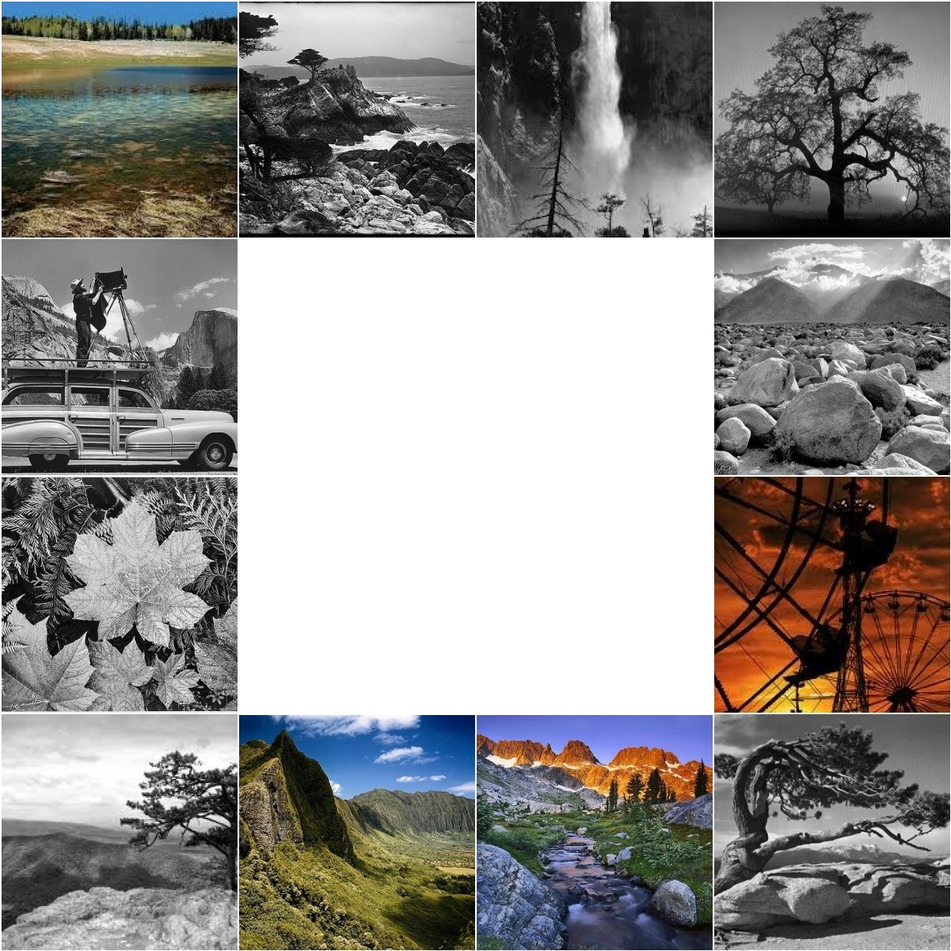
Geotagging
Ansel Adams’
Photographs
CSCI-548 Project Presentation
Pulkit Maheshwari
Amritaansh Verma

Slide 2
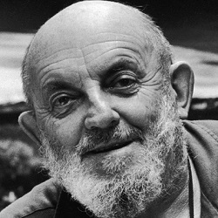
Who is Ansel Adams?
Ansel Easton Adams was one of the most famous American photographers.
He is rated as one of the best landscape photographers in the world.
Geotagging Ansel Adams’ Photos

Slide 3
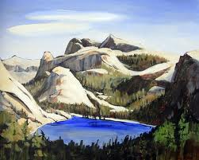
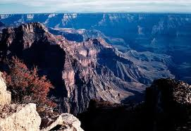
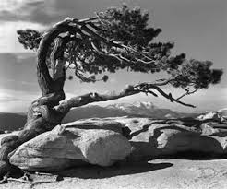
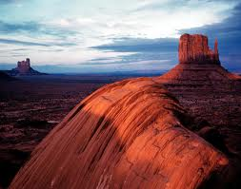
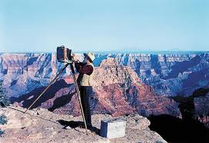
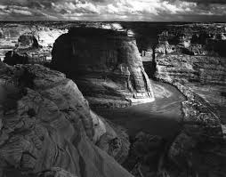
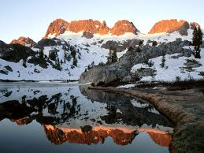
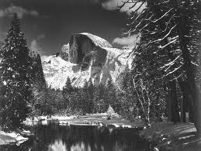
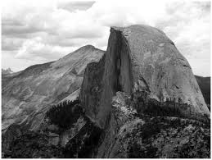
Why this topic?
Photos are not geotagged.
No single coherent structured source.
No way to visualize Ansel’s journey across the globe.

Slide 4
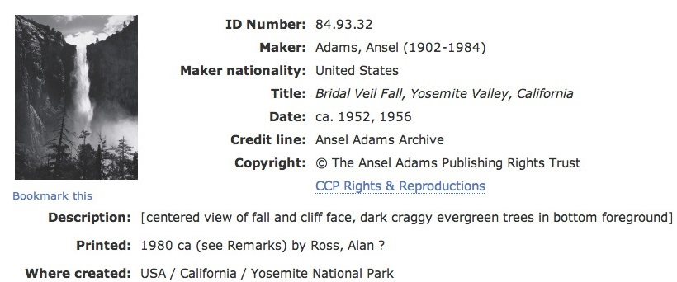
Data Sources
University of Arizona, Center for creative photography (ccp.uair.arizona.edu)
Library of Congress, Ansel Adams' collection www.loc.gov
US National Archives http://www.archives.gov/research/ansel-adams/

Slide 5
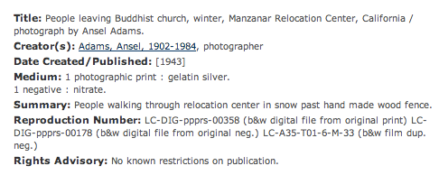
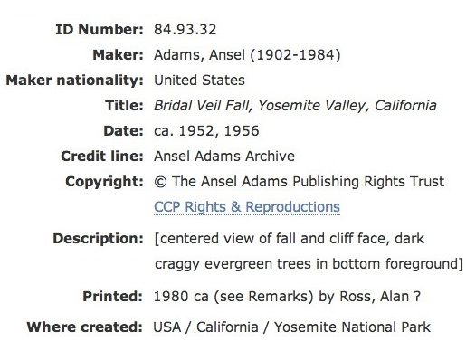
Challenges
Incoherent structure of sources

Slide 6
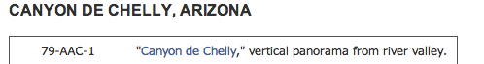
Challenges
Messy Data
No explicit location information

Slide 7
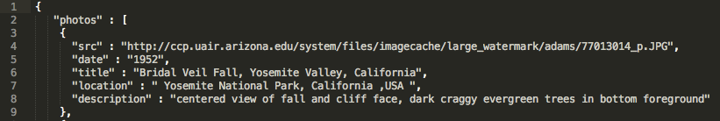
Scraping the data
A python based framework for crawling and scraping data off websites
SCRAPY

Slide 8
Record Linkage using FRIL
Linkage criteria is the TITLE of the photo

Slide 9
Cleaning the Data
The scraped data was cleaned using Google Refine
4-digit year Example : 1942
Removed stray html tags, whitespaces and re-ordered
Example : Glacier Bay, Alaska, USA

Slide 10


Extracting location keywords using Open-Calais

Slide 11

Geocoding
Location entities returned by open-calais web service are concatenated and sent to Google Maps Geocoding API to retrieve coordinates for each photo

Slide 12
Geotagging each photo
Original data
Geo-location data for each photo

Slide 13
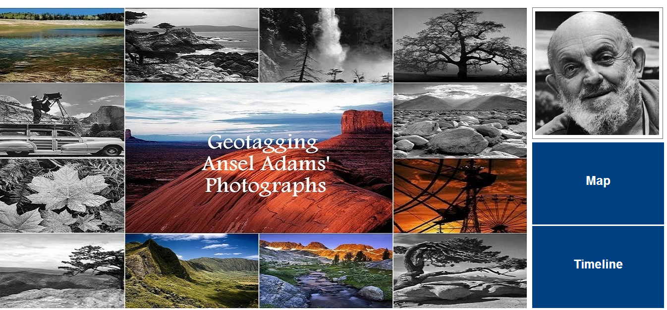
What we achieved!
http://www.pulkitmaheshwari.com/csci548.html

Slide 14
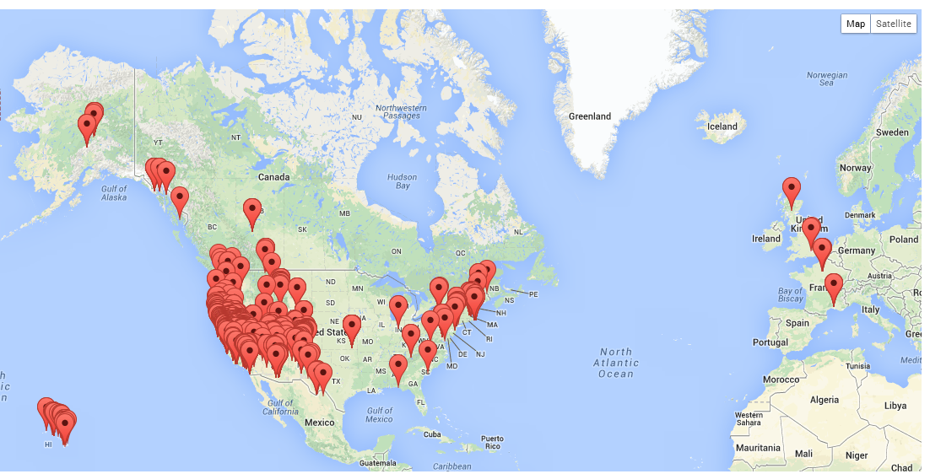
Geotagged Photos Visualized

Slide 15
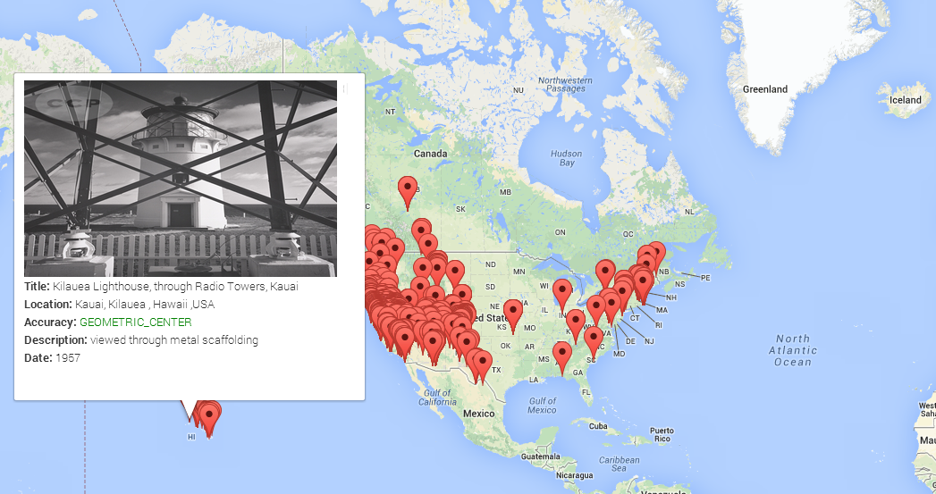
Information on each Pin

Slide 16
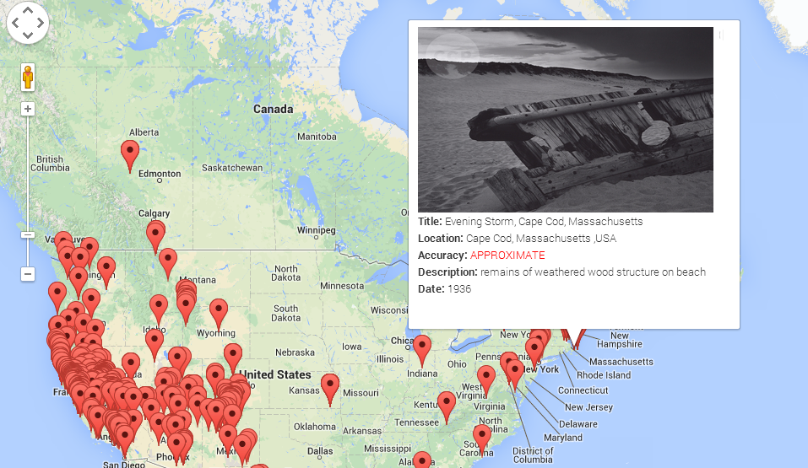
Information on each Pin

Slide 17
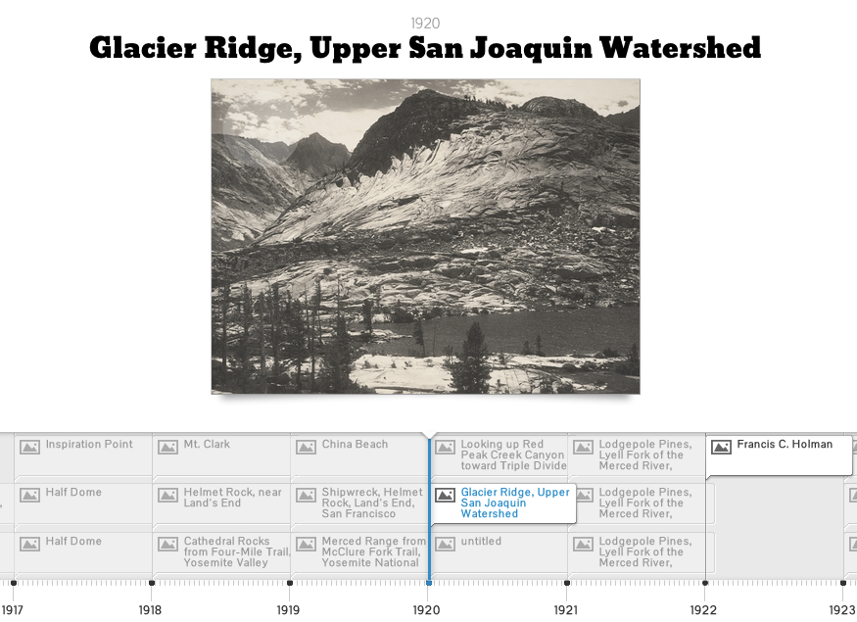
Timeline

Slide 18
Statistics
Records Linked using FRIL : 425 (Criteria : photo title)
After Linkage, total unique photo records : ~ 3500
After Removing records missing critical information : ~ 2800
Location entities returned by Open-Calais for : ~ 2500 photos
Photos plotted on timeline : ~ 2000
Photos successfully geocoded : ~ 2400

Slide 19
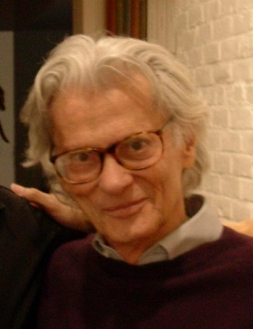
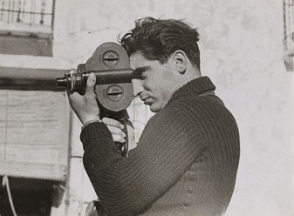
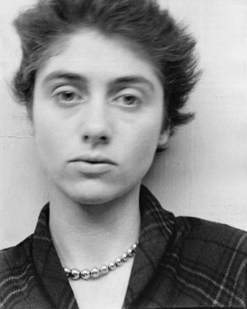
Future Work
Extending the project to cover other famous photographers and sources.
Disambiguating photos from various sources by using mathematical tools such as Fourier Transform.
Evaluating the correctness of the geocoded coordinates by manually geo-coding a subset of photos and comparing them with the API’s output.

Slide 20
Thank You!
References
University of Arizona, Center for creative photography (ccp.uair.arizona.edu)
Official Government data (www.archives.gov/research/ansel-adams)
Library of Congress (www.loc.gov)
Tools and Technologies Used :
Scrapy – web scraping and crawling framework
FRIL – record linkage tool
Google Refine – cleaning the data
Open-Calais Web Service API
Google Geocoding API
Eclipse IDE
Google Maps API
Timeline JS
Twitter Bootstrap

